Slide 1
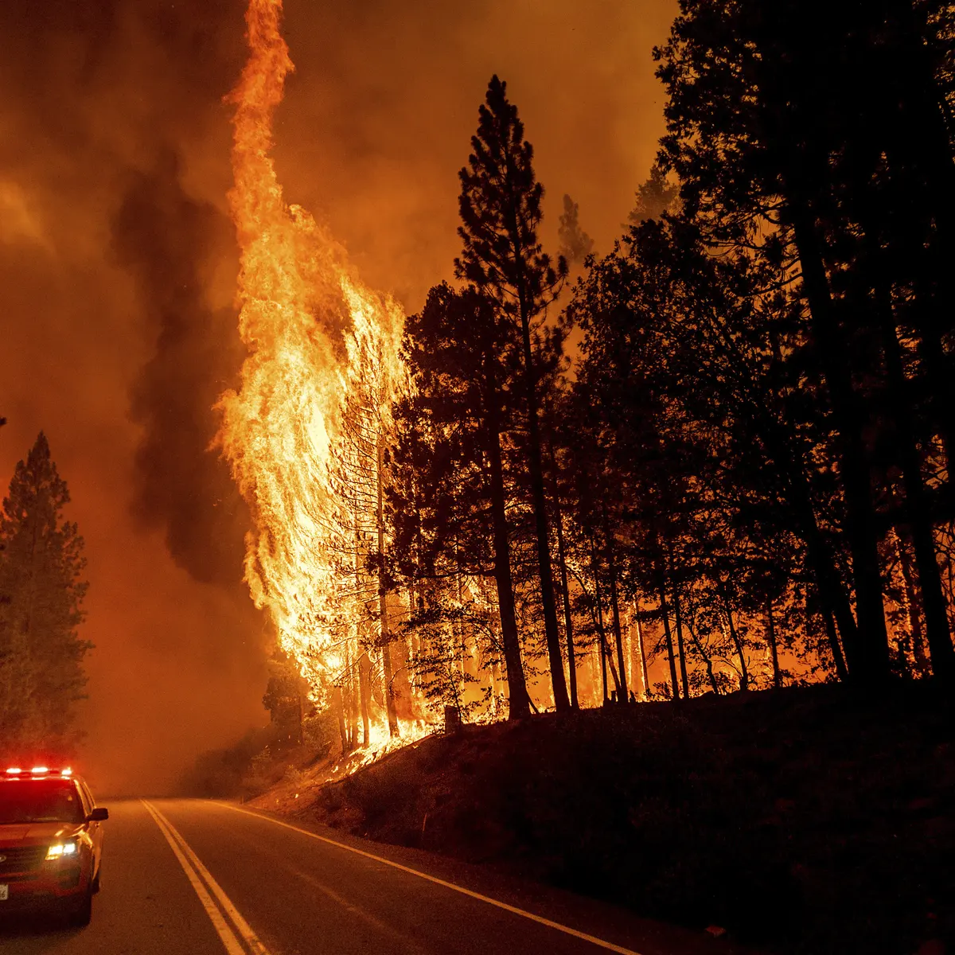
CALIFORNIA WILDFIRE
UC Berkeley Extension Bootcamp
Data Analytics and Visualizations
Fall 2021
Due Date: 10/07/2021
Presented By: Taravat Sharafat, Dhivya Ram, Shailee Madhani, Anupriya Sarkar
Notes:
Selected Topic: California WildFire

Slide 2
DATA SOURCE
Kaggle : https://www.kaggle.com/ananthu017/california-wildfire-incidents-20132020
Fires, impacts, location, duration
CA Gov : https://gis.data.ca.gov/datasets/CALFIRE-Forestry::recent-large-fire-perimeters-5000-acres/about
Fires, causes
SimpleMaps : https://simplemaps.com/data/us-counties
List of california counties and its geographic coordinates
Notes:
Talk about the authenticity of CA gov data, how kaggle data has enumerous amouts of imp info

Slide 3
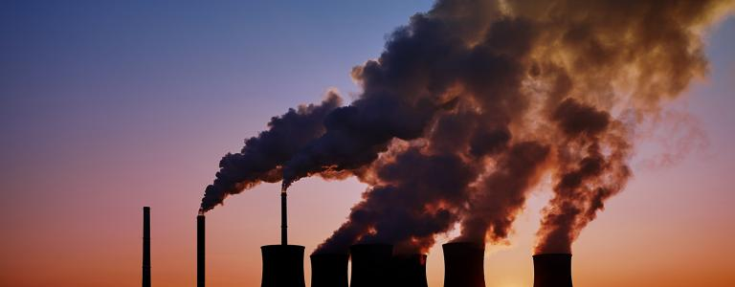
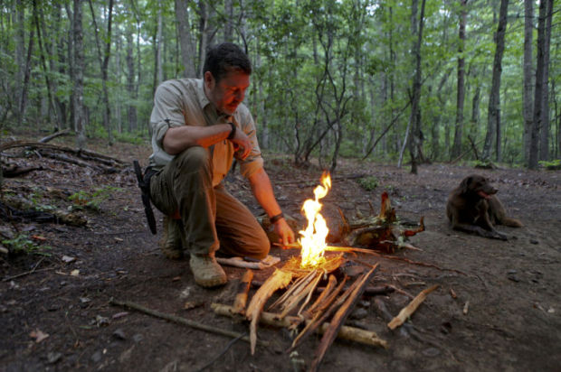
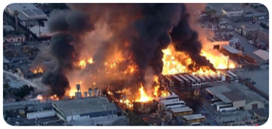
WHY CALIFORNIA WILDFIRES?
Wildfires are becoming major concern year by year which drove us to dig deeper into this area.
Analyze impacts, causes and trends of wildfires between 2013-2019.
Predicting the severity of the wildfire.
Notes:
Reasons the topic was selected.

Slide 4

WHAT QUESTIONS IS OUR DATA ANSWERING?
Percentage of structures impacted.
1
Relation of weather condition versus wildfire intensity.
2
California’s most affected counties.
3
Various causes leading to wildfire.
4
Notes:
Questions team are going to get addressed from the datasets.

Slide 5
DATA EXPLORATION
2
4
Data load
Handling Null Values
Join/Merge Dataset
Data Duplication Removal
Treat Missing Values
1
3
5
Notes:
Data load : Python pandas to load data from 2 sources into different dataframe.
Removal of data duplication : Consolidated the data from various sources by removing duplicates to maintain accuracy and to avoid misleading statistics.
Handling null values : To maintain performance and accuracy of ML model replaced/dropped the null values with some appropriate values based on the column type
Treat missing values : Filled in some missing values required for our analysis using a python library called MeteoStat and by loading a new dataset.
Merge/Join Dataset : Combined data sources on two common columns by incorporating majority of the columns for the main dataset.

Slide 6
DATA EXPLORATION
Data load: Python pandas to load data from 2 sources into different DataFrame.
1
Removal of data duplication: Consolidated the data from various sources by removing duplicates to maintain accuracy and to avoid misleading statistics.
2
Handling null values: To maintain performance and accuracy of ML model replaced/dropped the null values with some appropriate values based on the column type.
3
Treat missing values: Filled in some missing values required for our analysis using a python library called MeteoStat and by loading a new dataset.
4
Merge/Join Dataset: Combined data sources on two common columns by incorporating majority of the columns for the main dataset.
5
Notes:
Talk about how data had null, duplicate values, incorporation of weather data and missing latitude and longitu

Slide 7
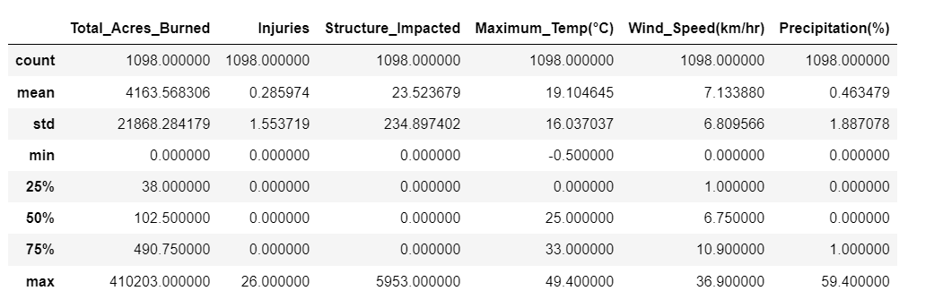
DATA EXPLORATION
Statistical summary : Statistical description on the final dataset.
6
Notes:
Talk about max, mean temp, max acres burned , develop some relation .

Slide 8
DATA ANALYSIS FLOW DIAGRAM
Loading Data
Cleaning Data
Storing Data
Machine Learning Modeling
California Fire Incidents
California Fire Perimeters
Python
Pandas
PostgreSQL
Logistic Regression
Dashboard
Notes:
Project Roadmap Flow Chart

Slide 9
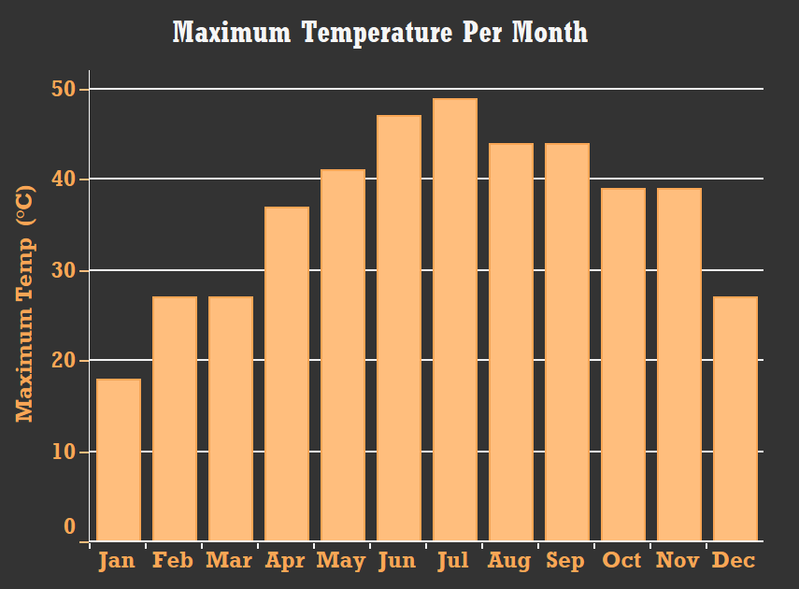
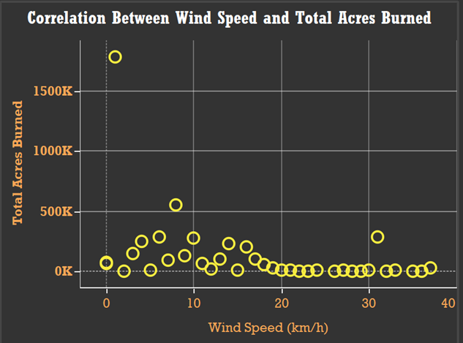
DATA ANALYSIS

Slide 10
